Slide 1
Miller-rabin test
on
risc-v

Slide 2
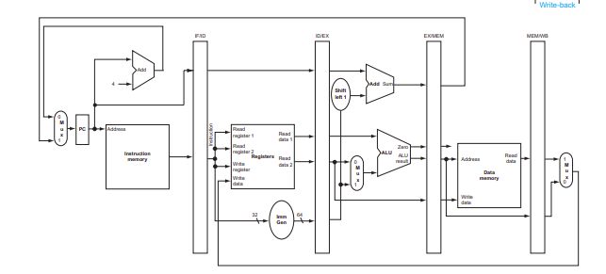

Slide 3
basics
An algorithm to determine if a number is prime
Features
    Unconditional
    Probabilistic
    Efficient

Slide 4
Motivation
Point of being able to tell if a
MULTI-HUNDRED DIGIT
is prime
?

Slide 5
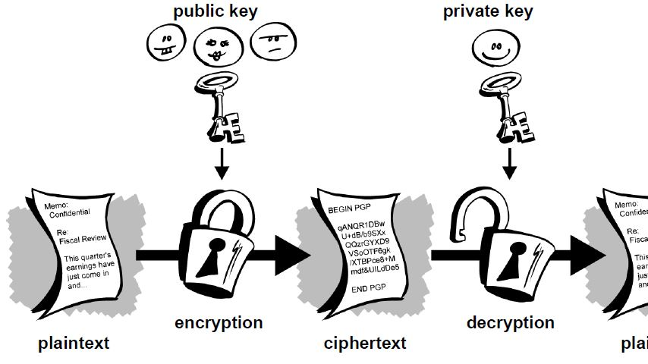
Public KEY Cryptography

Slide 6
Prime generation
For RSA to work, keys are required
To generate keys primes are required

Slide 7
Prime generation
Brute force method
Not feasible for large numbers

Slide 8
Solution
Use sufficient rounds of Miller Rabin test

Slide 9
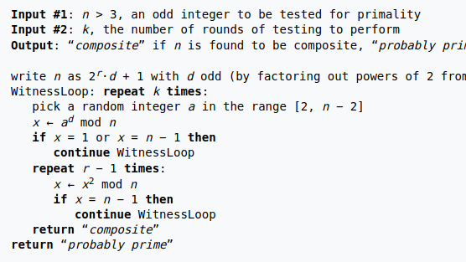
Algorithm

Slide 10
:)
Odds of getting a false positive after 50 rounds are less than the odds of a cosmic ray flipping a bit in deterministic test

Slide 11
:)
Algorithms maybe deterministic
BUT
the computers they run on are not

